Slide 1

Analysis of Adverse Drug Effects Using Big Data and Cloud Computing
Leveraging data to enhance drug safety and protect patients
Notes:
Objective: To identify and analyze patterns in adverse drug reactions to support safer prescription practices and patient care.

Slide 2
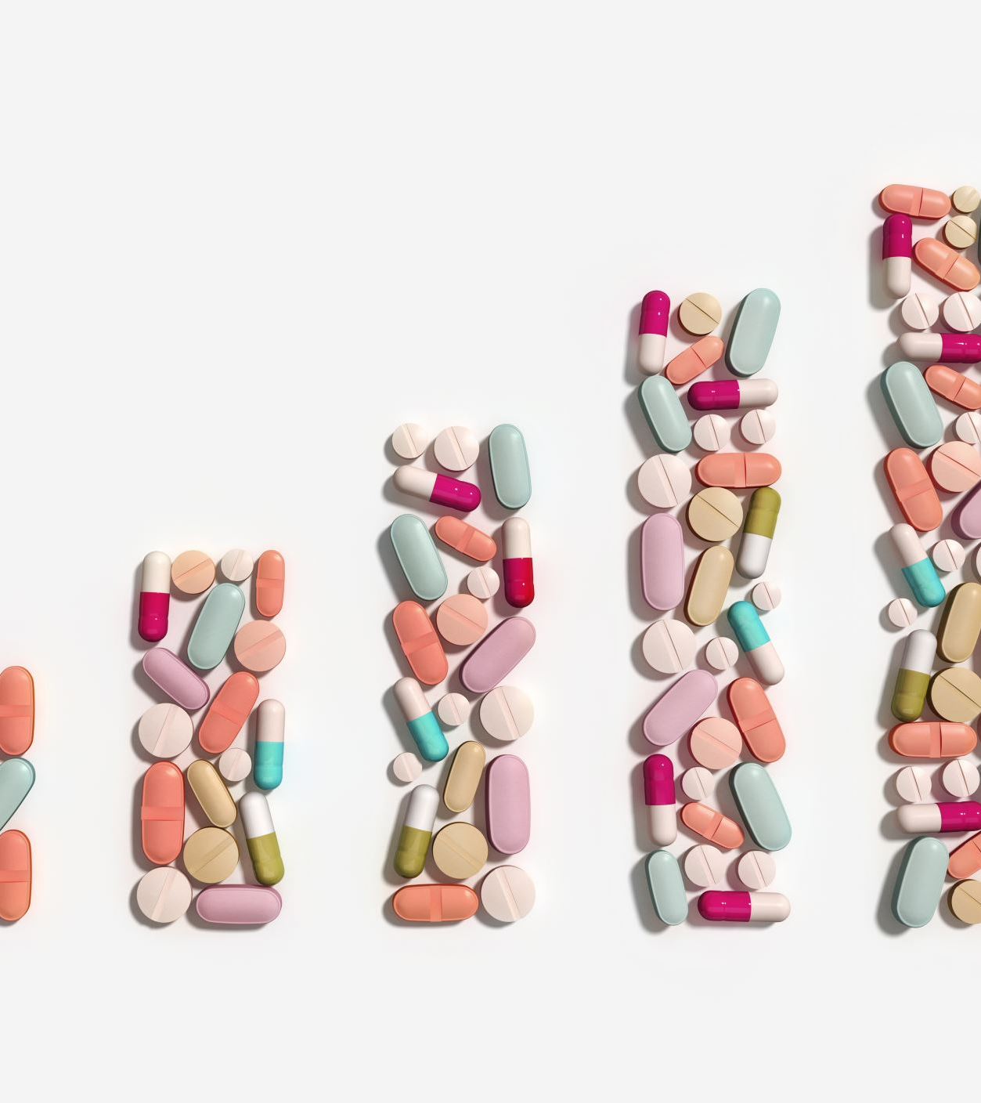
Project Overview & Motivation
Objective: Investigate adverse drug reactions (ADRs) using big data, extracting insights on drug safety for improved patient care.
Why This Matters: ADRs are a leading cause of hospitalizations, affecting patient safety and healthcare costs. Insights from ADR patterns can assist in refining drug prescription guidelines, improving public health outcomes.
Impact of the Study: Empower healthcare providers with data-driven insights for better risk assessment. Contribute to public safety by identifying high-risk drugs or combinations early.

Slide 3

Dataset Description & Collection Process
Source of Data: FDA Adverse Event Reporting System (FAERS).
Dataset Format and Structure: Initially in JSON format, containing structured fields that detail patient demographics, drug information, and reaction types. Unique reports are identified by safetyreportid, and each report includes patient data, reaction descriptions, and drug administration details.
Conversion to CSV: Parsing JSON using Python to extract relevant columns and format them into CSV for efficient analysis and compatibility with Apache Spark.

Slide 4

Project Workflow and Data Pipeline
Step 1: Data Collection - Import JSON files from FDA databases and store them in Google Cloud Storage.
Step 2: Data Transformation & Cleaning - Convert JSON to CSV and clean the dataset to ensure completeness and accuracy.
Step 3: Data Processing on Apache Spark - Utilize Spark on Google Cloud for scalable data processing and to handle the extensive size of the dataset.
Step 4: Exploratory Data Analysis (EDA) - Analyze trends in adverse reactions by patient demographics, drug types, and dosage.
Step 5: Visualization and Insights - Use data visualization tools (e.g., Matplotlib, Tableau) to create dashboards and interpret results.
Step 6: Interpretation and Reporting - Document key findings and recommend safety measures based on observed patterns.

Slide 5

Key Columns and Their Definitions
1. safetyreportid - Unique identifier for each report.
2. reactionmeddrapt - Type of adverse reaction (target column).
3. medicinalproduct - Name of the drug associated with the reaction.
4. patientsex and patientonsetage - Patient demographics to help identify any gender- or age-based patterns in reactions.
5. drugdosagetext - Information on the prescribed drug dosage.
6. serious - Indicates if the reaction is classified as serious.
7. occurcountry - Country of occurrence for geographic analysis.

Slide 6
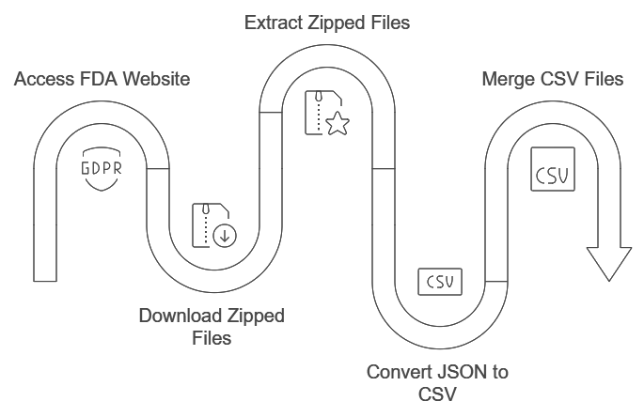
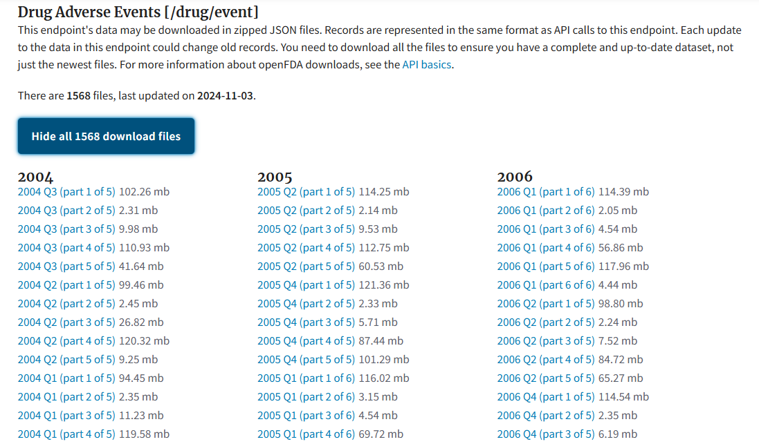
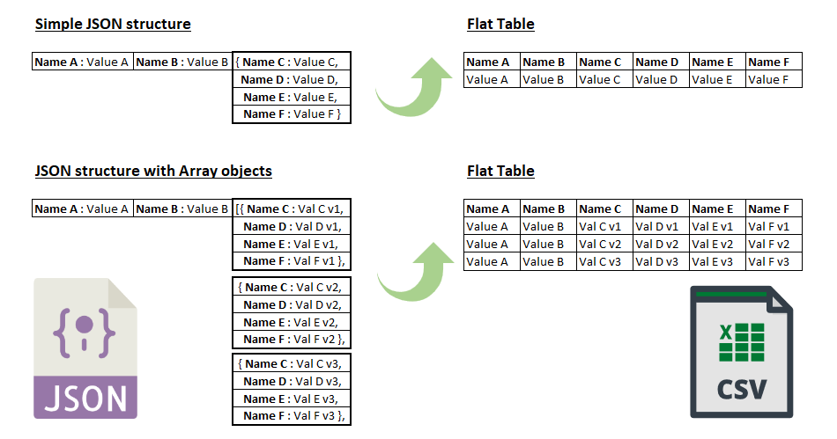

Data Collection

Slide 7
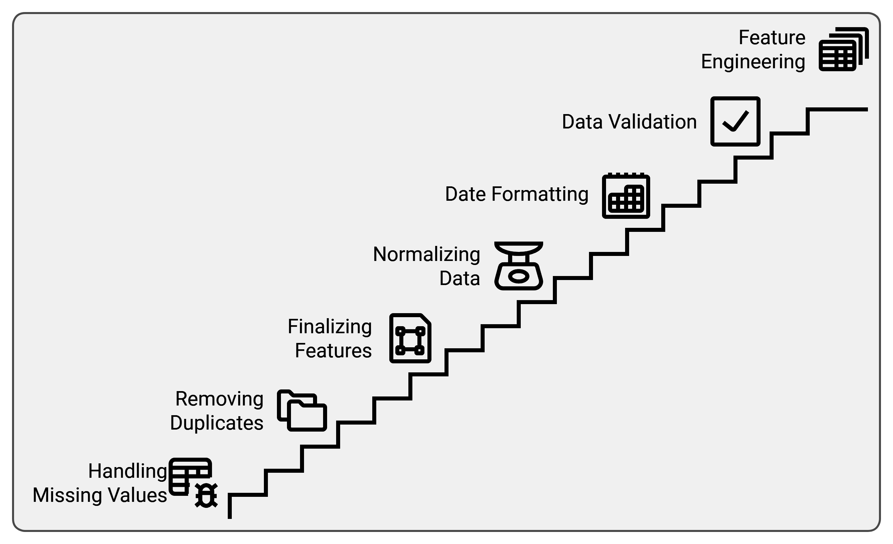
Data Cleaning & Preprocessing

Slide 8
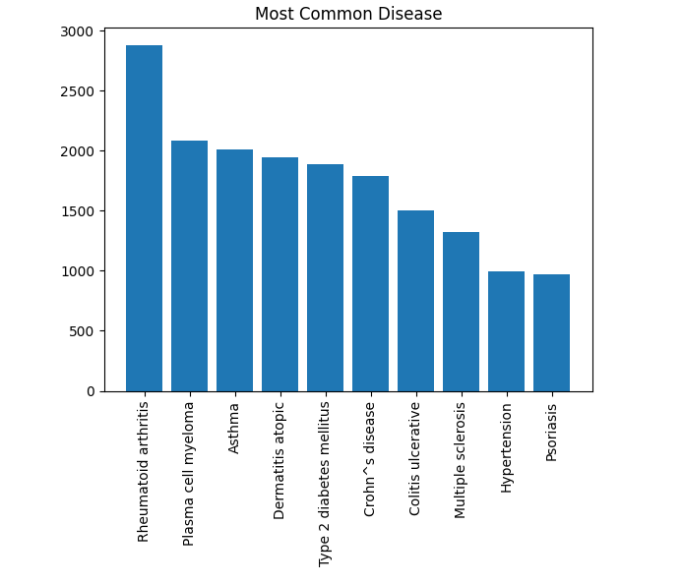
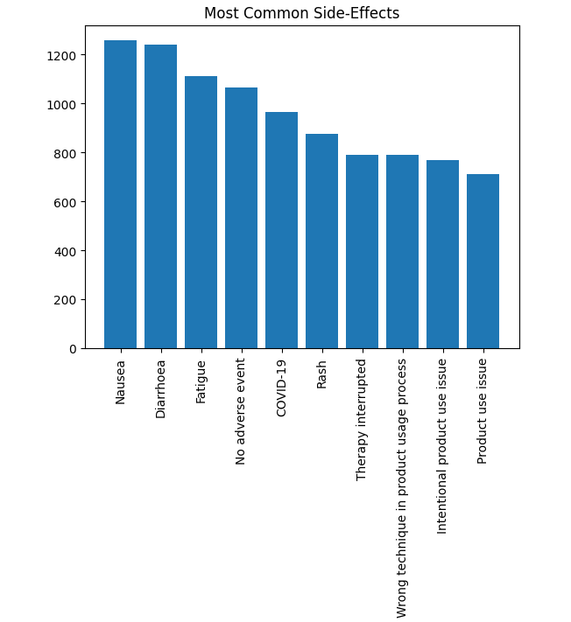
Data Visuals

Slide 9

Target Column and Projected Analysis
Target Column: reactionmeddrapt (Type of Adverse Reaction).
Purpose: Classify and quantify specific types of adverse reactions.
Analysis Goals: Identify correlations between specific drugs and high-frequency reactions, examine if patient demographics influence reaction likelihood or severity.

Slide 10

Platform Choice and Computational Tools
Cloud Platform: Google Cloud Platform (GCP) - Scalable storage, high-speed access, integration with big data tools.
Data Processing Framework: Apache Spark - Parallel processing capabilities for large datasets.
Visualization Tools: Matplotlib, Tableau for data presentation and dashboard creation.

Slide 11
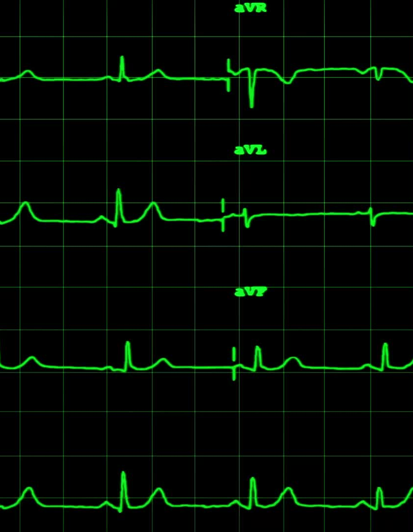
Feature Engineering Strategy
1. Drug Dosage Effect: Calculated using drugstructuredosagenumb and drugstructuredosageunit.
2. Geographical Insight: Map ADR frequency by occurcountry.
3. Age Groups and Gender Distribution: Explore age- or gender-specific adverse effects.
4. Severity Indexing: Build a severity index using serious, seriousnesshospitalization, and seriousnesslifethreatening fields.

Slide 12

Importance and Impact of the Project
Contribution to Drug Safety: Provides insights to healthcare on drug risks, highlighting high-risk drugs and potential demographic susceptibilities.
Support for Regulatory Bodies: Assists FDA and others in refining drug approval processes.
Public Health Impact: Potentially reduces ADR-related hospitalizations, improving patient safety and therapeutic effectiveness.

Slide 13

Expected Outcomes and Insights
1. Adverse Reaction Profiles - Summary of common adverse effects per drug.
2. Demographic-Based Insights - Patterns in reactions based on age and gender.
3. Risk Identification - List of high-risk drugs and doses.
4. Geographic Analysis - ADR trends by region.
5. Recommendations - Best practices for healthcare providers.

Slide 14

Challenges and Solutions
Data Complexity and Volume: Addressed by Apache Spark and GCP.
Data Inconsistencies and Missing Values: Resolved through rigorous data cleaning.
Interpretability of Results: Clear visualizations and summary statistics to convey insights.

Slide 15
Future Enhancements and Scalability
1. Real-Time ADR Analysis: Integrate real-time data feeds for dynamic monitoring of drug safety profiles.
2. Advanced Machine Learning Models: Explore classification models to predict high-risk cases.
3. Broader Dataset Integration: Incorporate additional data sources like lifestyle or co-morbidity information for a holistic view of ADRs.

Slide 16

Conclusion and Key Takeaways
Summary of Key Points: Comprehensive ADR analysis using big data, cloud infrastructure, and scalable processing.
Identified crucial insights on drug safety to aid clinical decision-making.
Final Thought: This project demonstrates the power of data-driven insights in enhancing drug safety, with potential to save lives and reduce healthcare costs.

Slide 17
Thank you

